Slide 1
HMH Science Dimensions
Biology
Unit 4: Ecosystems: Stability and
Change
Lesson 1: Population Dynamics
Notes:
The learning experiences in this unit prepare students for the mastery of
Performance Expectations
HS-LS2-1 Use mathematical and/or computational representations to support explanations of factors that affect carrying capacity of ecosystems at different scales.
HS-LS2-2 Use mathematical representations to support and revise explanations based on evidence about factors affecting biodiversity and populations in ecosystems of different scales.
HS-LS2-6 Evaluate the claims, evidence, and reasoning that the complex interactions in ecosystems maintain relatively consistent numbers and types of organisms in stable conditions, but changing conditions may result in a new ecosystem.

Slide 2

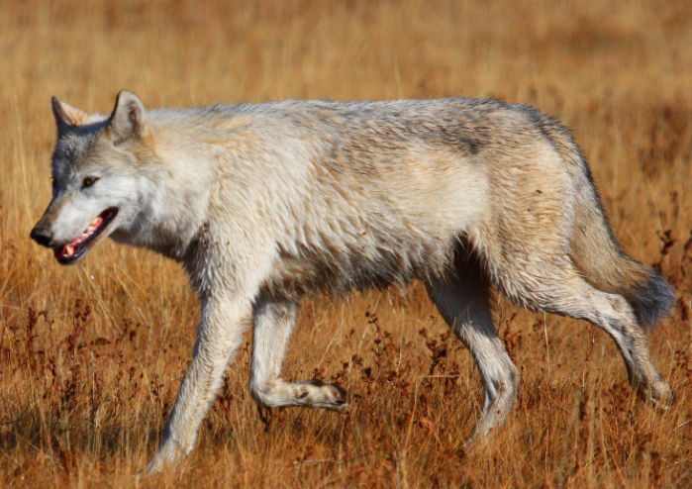
Can You Explain It?
Unit 4 Lesson 1
How might the reintroduction of wolves into Yellowstone National Park have caused both direct and indirect changes in populations of so many other species within their ecosystem?
Gray wolf (Canis lupus)
Notes:
Lesson Objective
Use mathematical and computational representations to explain how factors affect population density, distribution, and growth patterns, and how limiting factors affect an ecosystem’s carrying capacity.

Slide 3
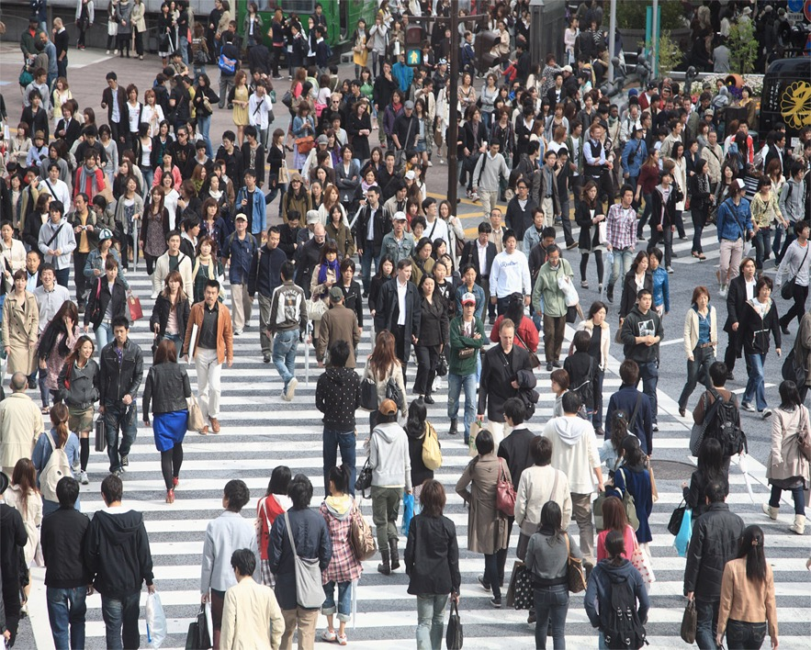
Population Density and Dispersion
Unit 4 Lesson 1
COLLABORATE
With a partner, discuss whether the area where you live has a dense or dispersed population. Explain your reasoning.
Cities have dense human populations.

Slide 4

Population Density and Dispersion
Unit 4 Lesson 1
A scientist counted 200 individual deer in an area of 10 square kilometers.
What is the population density?

Slide 5
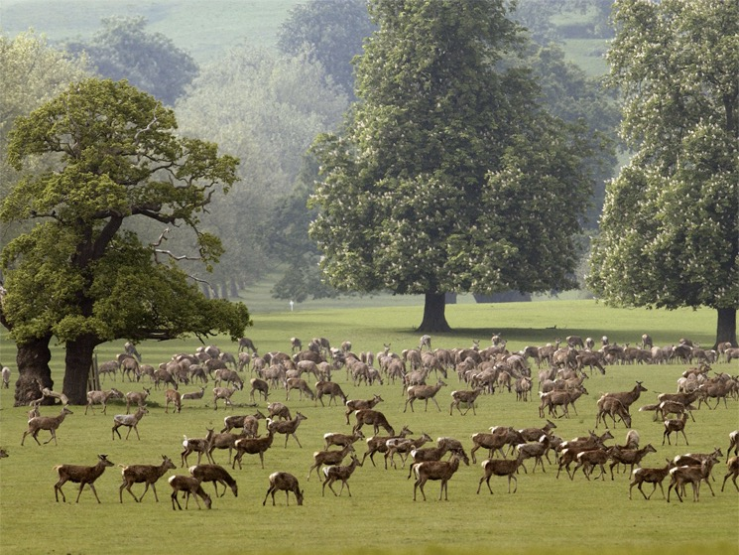
Population Density and Dispersion
Unit 4 Lesson 1
Ten years later, scientists return to the same area and find that the population density has declined to 5 deer per square kilometer.
What might a decrease in the density of a deer population tell scientists about the habitat in the area?

Slide 6
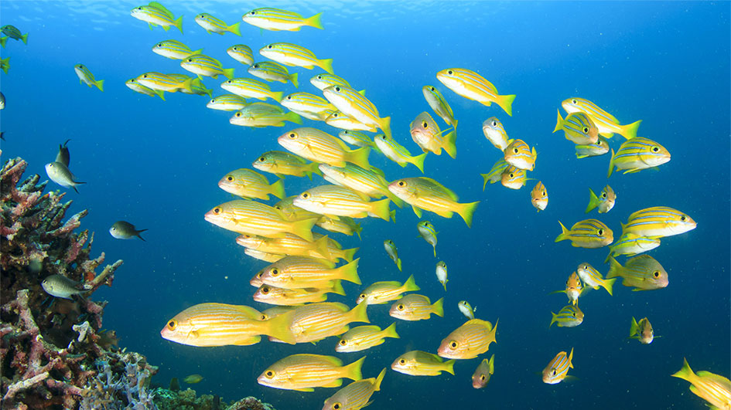
Population Density and Dispersion
Unit 4 Lesson 1
Clumped dispersion occurs when resources are spread unevenly within an ecosystem. Individuals gather into groups where resources are available.

Slide 7
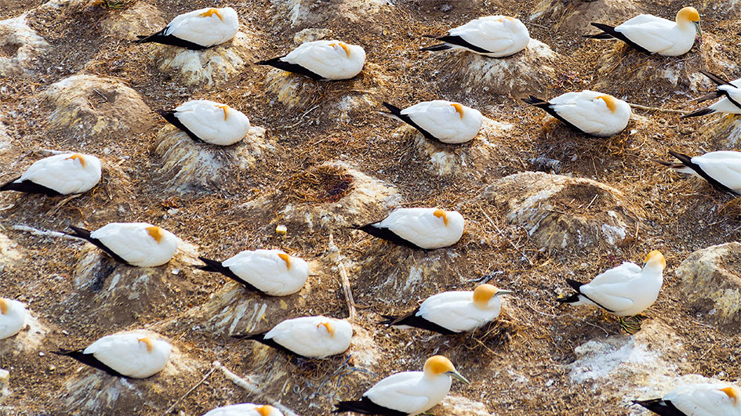
Population Density and Dispersion
Unit 4 Lesson 1
Uniform dispersion occurs when individuals of the same species must compete for limited resources and territory.

Slide 8
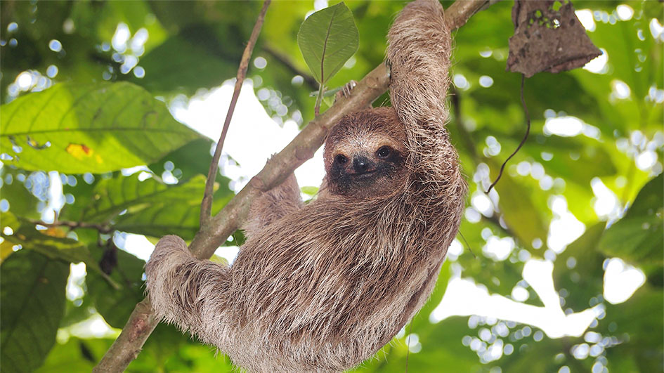
Population Density and Dispersion
Unit 4 Lesson 1
Random dispersion is the least common pattern of distribution. It occurs when resources are evenly distributed within an ecosystem.

Slide 9
Population Density and Dispersion
Unit 4 Lesson 1
ANALYZE
Why might a population exhibit uniform dispersion?
Think about why having a defined space might be beneficial

Slide 10
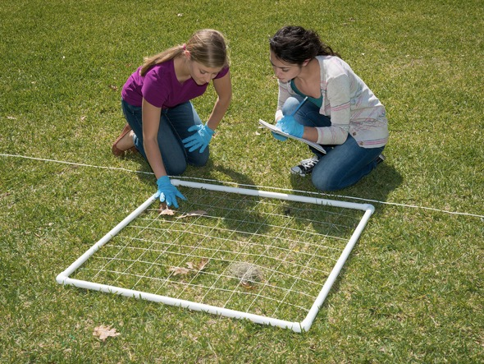

Population Density and Dispersion Hands-On Lab: Quadrat Sampling
Unit 4 Lesson 1
Use a quadrat sampling method to collect data about population numbers

Slide 11
Population Density and Dispersion Scale Proportion and Quantity
Unit 4 Lesson 1
Calculate the density of each species. Which species had the highest density? Which had the lowest? Why do you think that is? Compare your population estimates to the actual population number that your teacher provides. Was your estimate accurate? Why or why not?
How can you make sure that your estimate of population size will be as close to the actual population size as possible?
Why do scientists only gather data for a part of the population instead of the entire population? How does this affect the accuracy of the final population count?

Slide 12
Unit 4 Lesson 1
Population Density and Dispersion
EXPLAIN
In Yellowstone National Park, scientists track and gather data on many species to study population dynamics within the park and to monitor the health of each population.
Describe the types of data that scientists would need to gather to study the effects of reintroducing a population, such as wolves, on other populations in the park.

Slide 13
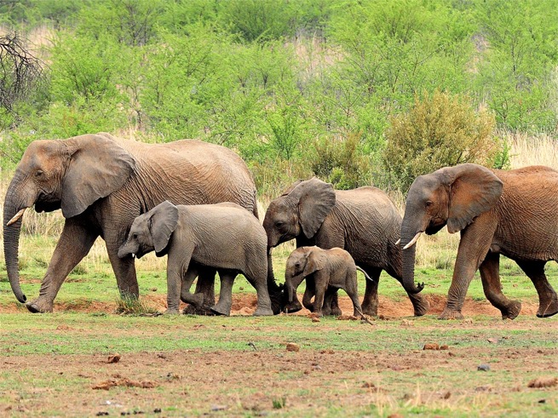
Population Growth Patterns:
Unit 4 Lesson 1
A population of elephants has both young and old individuals.
Which factors lead to an increase in population?
Which factors lead to a decrease in a population?
What might happen to populations that cannot get enough resources?

Slide 14
Unit 4 Lesson 1
Population Growth Patterns
Problem Solving
r = (b + i) – (d + e)
r = population growth rate,
b = birth rate i = immigration rate
d = death rate e = emigration rate.
As part of a long-term elephant study, biologists counted individuals in a population of elephants each spring. In one year, there were 18 males and 34 females.
Over the following year, each female gave birth, of which 28 survived. Nine elephants died due to predators.
A construction project cleared 50 acres of nearby forested land, causing 5 males and 19 females to immigrate into the experimental area. Competition for females increased, resulting in the emigration of 10 males to a new territory in search of mates.
What is the growth rate of this population?

Slide 15
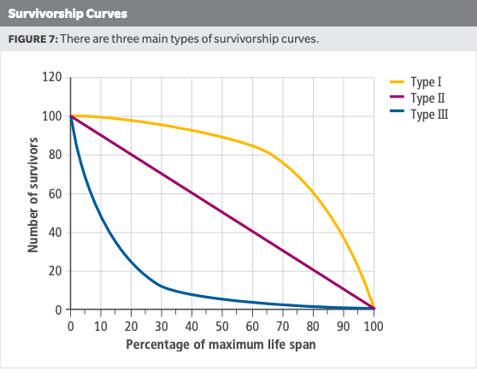
Unit 4 Lesson 1
Population Growth Patterns
A survivorship curve
is a simplified diagram that shows the number of surviving individuals over time from a measured set of births.
COLLABORATE
With a partner, discuss which type of survivorship humans might exhibit.

Slide 16

Unit 4 Lesson 1
Population Growth Patterns
ANALYZE
Can a survivorship curve be used to determine whether or not a species cares for their young?
Explain your answer

Slide 17
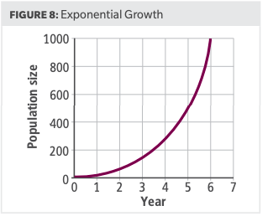
Unit 4 Lesson 1
Population Growth Patterns
Exponential growth, occurs when a population size increases dramatically over a relatively short amount of time.
A graph of exponential growth looks like a J-shaped curve

Slide 18
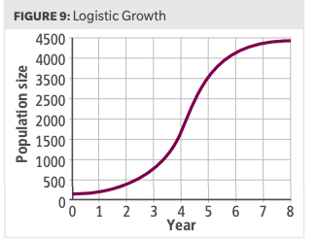
Unit 4 Lesson 1
Population Growth Patterns
During logistic growth, a population begins with a period of slow growth followed by a period of exponential growth before leveling off at a stable size.
A graph of logistic growth takes the form of an S-shaped curve.

Slide 19
Unit 4 Lesson 1
Population Growth Patterns
EXPLAIN
When wolves were reintroduced into Yellowstone National Park, the populations of many other species began to change.
Which factors would scientists want to measure to learn how each population changed over time?
How would scientists know if populations were increasing or decreasing over time?
How might the introduction of wolves change the growth patterns of other species?

Slide 20
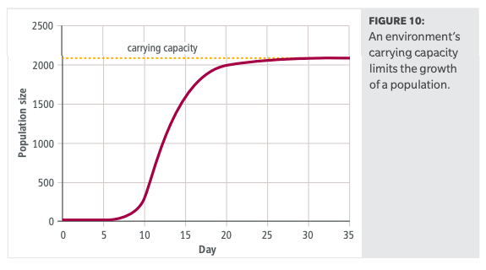
Unit 4 Lesson 1
Factors that Limit Population Growth
The carrying capacity of an environment is the maximum population size of a species that a particular environment can normally and consistently support in terms of resources.
How might this graph change if an ecosystem experienced drought conditions?

Slide 21
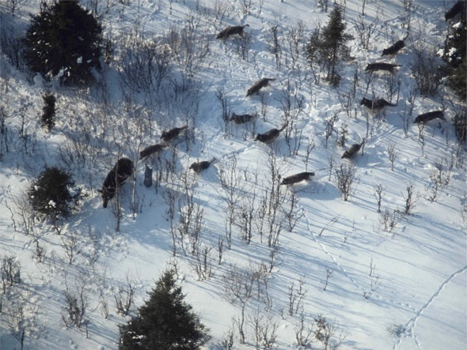
Unit 4 Lesson 1
Factors that Limit Population Growth
Density–dependent limiting factors are factors that are affected by the number of individuals in an area.
Both plants and animals compete among themselves for needed resources.
The relationship between predator and prey in an environment is ongoing and constantly changing.
Parasites are much like predators as they live off their hosts,

Slide 22
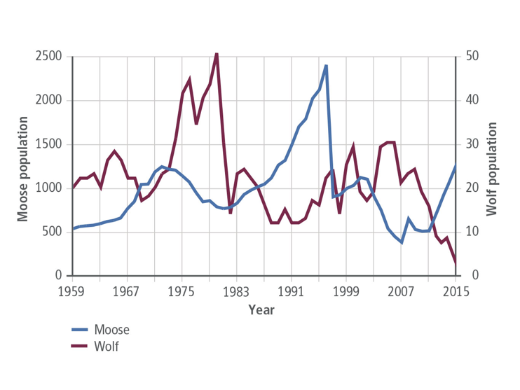
Unit 4 Lesson 1
Factors that Limit Population Growth
Predator-Prey Interactions on Isle Royale
ANALYZE
Study the graph showing the moose–wolf interactions on Isle Royale. Based on this graph:
What is the most likely explanation for the increase in the moose population between 1989 and 1995?

Slide 23
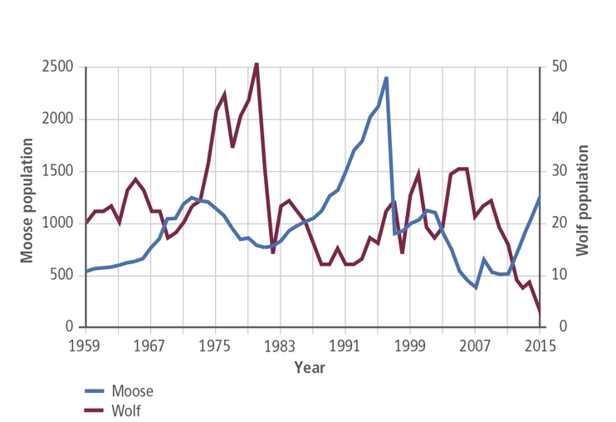
Unit 4 Lesson 1
Factors that Limit Population Growth
Predator-Prey Interactions on Isle Royale
ANALYZE
In 2016, the wolf population on Isle Royale declined to only two individuals.
How will the lack of wolves affect the moose population?
Will the moose population grow exponentially? Explain your answers

Slide 24
Unit 4 Lesson 1
Factors that Limit Population Growth
Density–independent limiting factors are factors that can impact a population regardless of its density.
Weather: Any weather-related event such as a drought, flood, frost, or severe storm
Natural Disasters: Volcanic eruptions, earthquakes, tsunamis, and fires
Human Activities: forest clearing, draining of wetlands for land development, and habitat fragmentation by roads and fences.

Slide 25
Unit 4 Lesson 1
Factors that Limit Population Growth
GATHER EVIDENCE
When wolves were reintroduced into Yellowstone National Park, scientists noticed that the populations of elk and coyotes decreased. They also noticed that populations of beaver and willow trees increased.
Describe the factors that might have led to these changes in the different populations.
Explain how these factors would affect the carrying capacity of the environment for each species.

Slide 26
Unit 4 Lesson 1
Continue Your Exploration
Choose one of the paths below to continue your exploration:
Career: Biogeographer
Population Density and Carrying Capacity
Controlling the Exponential Growth of Nonnative Species

Slide 27
Can You Explain It?
Unit 4 Lesson 1
Refer to the notes in your Evidence Notebook to help you explain how the reintroduction of wolves into the Greater Yellowstone Ecosystem might have caused both direct and indirect changes in the populations of so many other species within their ecosystem. Consider the following questions when developing your explanation:
Write a short explanatory text that cites specific evidence from this lesson about population dynamics to support your answer.

Slide 28
Image Credits
Unit 4 Lesson 1
gray wolf ©SBTheGreenMan/iStock/Getty Images Plus; busy crosswalk ©Robert Harding/Wendy Connett/Getty Images; herd of deer ©Tim Graham/Alamy; school of fish ©Rich Carey/Shutterstock; gannet colony ©Moment/Stoneography/Getty Images; sloth ©Vilainecrevette/Shutterstock; group of elephants ©Michael Potter11/Shutterstock; wolves stalking moose ©Rolf O. Peterson; quadrat sampling ©HMH

